Slide 1
Purchase Requests in Alma Analytics
Yoel Kortick
Senior Librarian

Slide 2

Agenda
Introduction
Viewing a small selection of the many default reports
List of all default reports with explanation

Slide 3
Introduction

Slide 4
Introduction
Alma Analytics includes a dedicated subject area for purchase requests.
There is also a full set of default reports for purchase requests as well as a dashboard
The default List of all default reports with explanations are located under directory "Shared Folders / Alma / Purchase Requests"
See also the on line help: Alma Analytics Purchase Requests Subject Area

Slide 5
Introduction
With this subject area institutions can report on purchase requests thereby identifying which users are creating what kinds of requests in which areas. This can be a valuable component in determining collection management.
As we will see, this subject area includes data on the bibliographic record, the creator, user to whom it is assigned, the status of the request, and a myriad of predefined measures.
When the purchase request results in a POL then the POL number is also included and can then be used as an input in other subject areas.

Slide 6
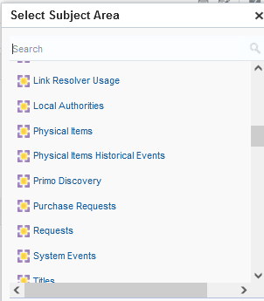
Introduction
Purchase Requests subject area

Slide 7
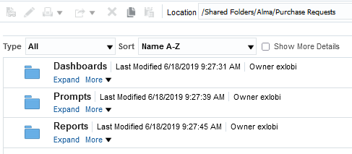
Introduction
Set of default reports and dashboard

Slide 8
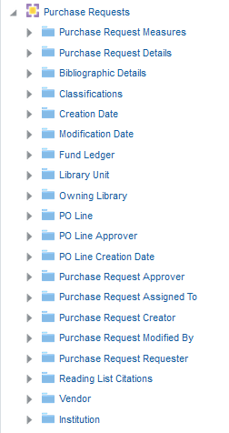
Introduction
The purchase requests subject area.

Slide 9
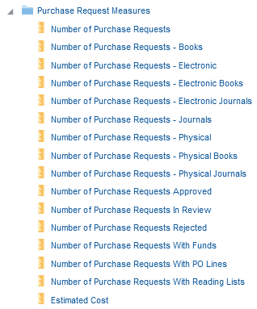
Introduction
Purchase Request Measures exist for all aspects of the Purchase Requests
Measures are prefiltered by various attributes
Number of purchase requests with no predefined filter
Citation type can be "Book" or "Journal"
Request format can be "Electronic" or "Physical"
Here we have every possible combination
Status can be "Approved", In Review" or "Rejected"
Purchase requests may be connected to Funds, PO Lines and Reading Lists

Slide 10
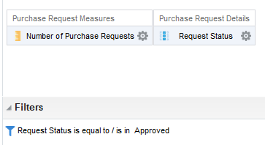

Introduction
For example, instead of filtering by "request status = approved" and displaying the "Number of Purchase requests" it is possible to use the predefined filter "Number of Purchase Requests Approved"
Instead of this
Can use this

Slide 11
Viewing a small selection of the many default reports

Slide 12
Viewing a small selection of the many default reports
On the next slide we have a report of Purchase Requests which have been assigned to a user but not updated for at least 30 days.
This can be used as an alert for the institution to take care of neglected purchase requests.
It filters by
  Modification date is equal or greater than 30 days ago
  Assignee is not empty
  Request status is not approved or rejected

Slide 13
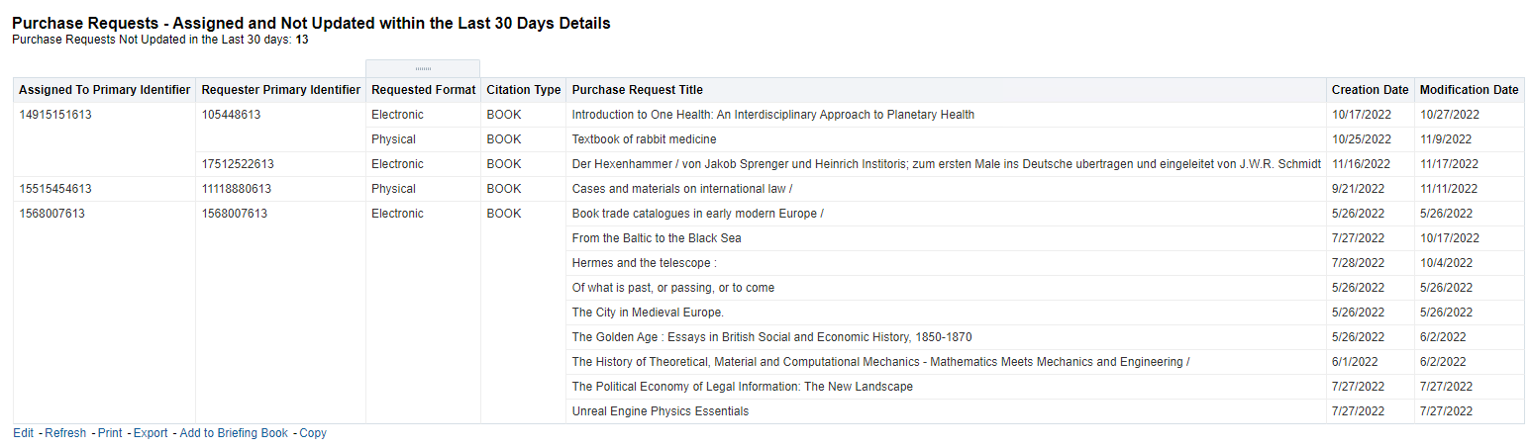
Viewing a small selection of the many default reports

Slide 14
Viewing a small selection of the many default reports
On the next slide we have a report of Top 10 Requested LC Groups Requests Created in Last 365 Days
This is useful for collection development, identifying what subject area are in highest request by users.
It filters by
  Creation date filter is in last 365 days
It displays measure
  Number of Purchase Requests
  LC Classification Group
  LC Classification Code

Slide 15
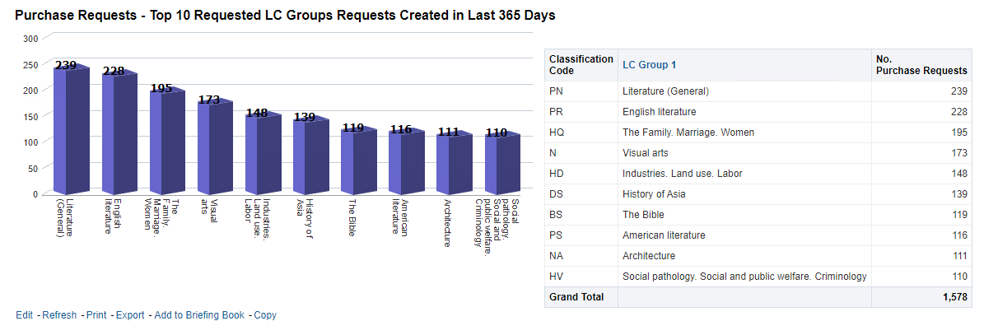
Viewing a small selection of the many default reports

Slide 16
Viewing a small selection of the many default reports
On the next slide we have a report of Quarterly Trend of Requests and Costs in the Previous Complete 8 Quarters
We can see for example that there has been a steady increase in the number of purchase requests and corresponding total price.
It filters by
  Creation date > 8 complete quarters ago
It displays measures
  Number of Purchase Requests
  sum("PO Line"."Net Price")

Slide 17
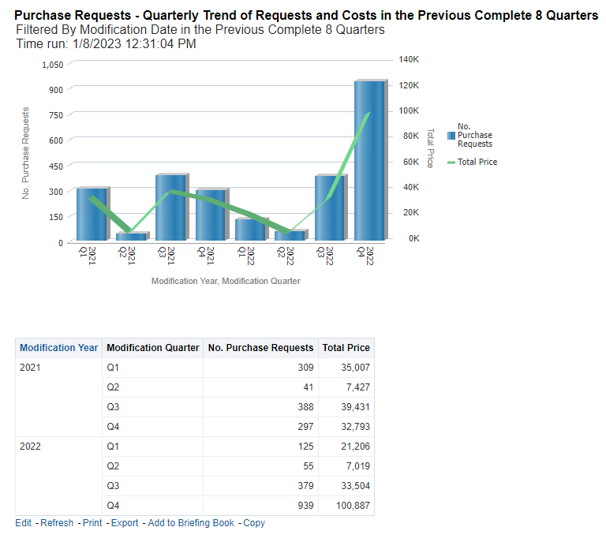
Viewing a small selection of the many default reports

Slide 18
Viewing a small selection of the many default reports
On the next slide we have a report of Purchase Requests Monthly Trend by Format and Type in the Previous Complete 12 Months
We can see for example that there have been many more requests for books than journals.
It filters by
  Creation date filter equals previous complete 12 months
It displays measures
  Number of Purchase Requests - Electronic Books
  Number of Purchase Requests - Electronic Journals
  Number of Purchase Requests - Physical Books
  Number of Purchase Requests - Physical Journals

Slide 19
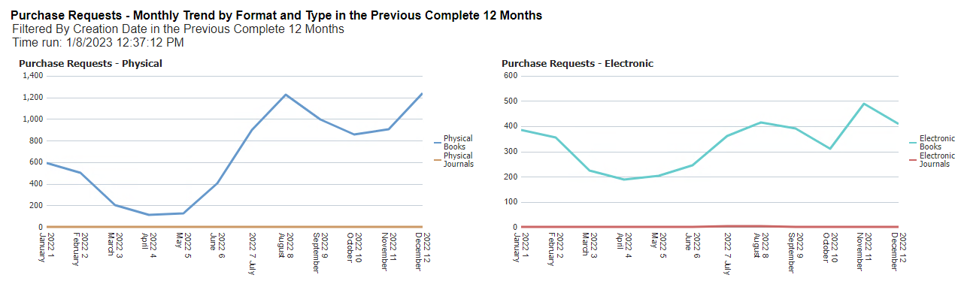
Viewing a small selection of the many default reports

Slide 20
Viewing a small selection of the many default reports
On the next slide we have a report of Purchase Requests Monthly Trend by Status in the Previous Complete 12 Months
We can see for example that there are many more "approved" requests than "rejected"
It filters by
  Creation date filter equals previous complete 12 months
It displays measures
  Number of Purchase Requests Approved
  Number of Purchase Requests Rejected

Slide 21
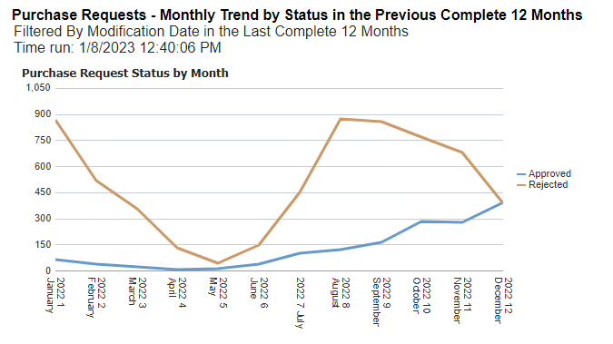
Viewing a small selection of the many default reports

Slide 22
Viewing a small selection of the many default reports
On the next slide we have a report of Monthly Trend of Requests and Costs in the Previous Complete 12 Months
We can see for example that, as expected, the overall cost of the POLs connected to Purchase Requests is relative to the numbers of Purchase requests (more Purchase Requests means a higher overall cost)
It filters by
  Creation date filter equals previous complete 12 months
It displays measures
  Number of Purchase Requests
  sum("PO Line"."Net Price")

Slide 23
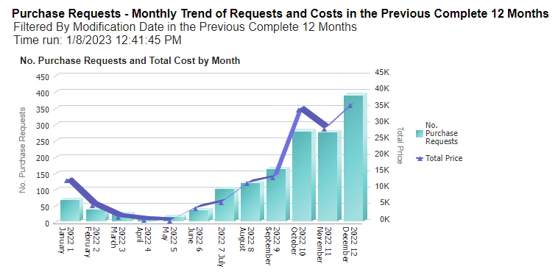
Viewing a small selection of the many default reports

Slide 24
Viewing a small selection of the many default reports
On the next slide we have a report of PO Line Reference Numbers from a Purchase Request in the Last 30 Days.
This can be used as an input report in any other subject area which contains the PO Line reference .
It filters by
  Creation date is less than or equal to 30 days ago
  Request status equals approved

Slide 25
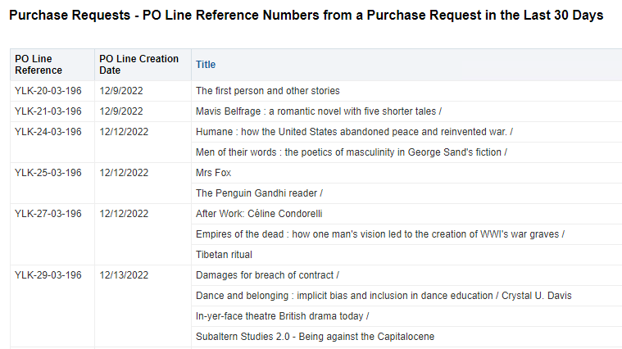
Viewing a small selection of the many default reports

Slide 26
Viewing a small selection of the many default reports
On the next slide we have a report of Request Handling Time from creation to rejected or approved in the Previous Complete 12 Months
This can be useful in monitoring handling time for new purchase requests
It filters by
  Creation date filter equals previous complete 12 months
It displays measures
  "Purchase Request Measures"."Number of Purchase Requests“
  AVG(TIMESTAMPDIFF(SQL_TSI_DAY, "Creation Date"."Creation Date", "Modification Date"."Modification Date"))
  MAX(TIMESTAMPDIFF(SQL_TSI_DAY, "Creation Date"."Creation Date", "Modification Date"."Modification Date"))
  MIN(TIMESTAMPDIFF(SQL_TSI_DAY, "Creation Date"."Creation Date", "Modification Date"."Modification Date"))

Slide 27
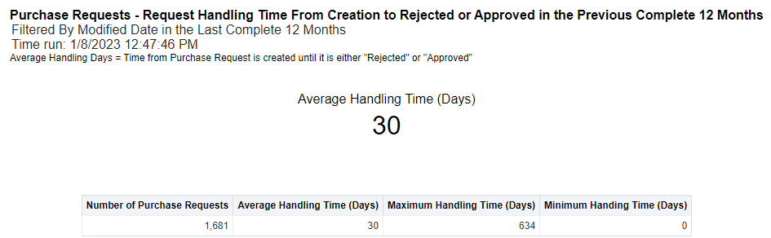
Viewing a small selection of the many default reports

Slide 28
List of all default reports with explanation

Slide 29
List of all default reports with explanation
Purchase Requests – Assigned and Not Updated within the Last 30 Days Details
  A List of Purchase Requests that have a Modification Date greater than 30 days ago, that are assigned, but are not finalized.
Purchase Requests – Monthly Trend by Format and Type in the Previous Complete 12 Months
  Two Line Charts (Physical and Electronic) showing number of requests over time, grouped by format. Dates are based on Creation Date
Purchase Requests – Monthly Trend by Status in the Previous Complete 12 Months
  A line chart of finalized requests over time (Modification Date), grouped by status.

Slide 30
List of all default reports with explanation
Purchase Requests – Monthly Trend of Requests and Costs in the Previous Complete 12 Months
  A combination chart of finalized requests showing the number of requests (bar) and total price (line - based on Net Price from PO Line) grouped over time (Modification Date.)
Purchase Requests – PO Reference Numbers from a Request in the Last 30 Days
  A List of PO Line References, PO Line Creation Date, and Titles that were created from Purchase Requests from requests created in the last 30 days.
Purchase Requests – PO Line IDs from a Request in the Last 365 Days
  A List of PO Line References, PO Line Creation Date, and Titles that were created from Purchase Requests from requests created in the last 365 days.

Slide 31
List of all default reports with explanation – example one of two
Purchase Requests – Quarterly Trend of Requests and Costs in the Previous Complete 8 quarters
  A combination chart and list of finalized requests, showing number of requests (bar) and total price (line - based on Net Price of PO Line) over time, grouped by quarter (Modification Date).
Purchase Requests – Request Handling Time from creation to rejected or approved in the Previous Complete 12 Months
  Statistics showing number of requests, average, minimum and maximum handling time (in days) of requests. Handling time is time from the creation of the request until its status is finalized (using the creation and modification dates.)
Purchase Requests – Request Handling Time from creation to rejected or approved in the Previous Complete 12 Months Details
  Statistics showing number of requests, average, minimum and maximum handling time (in days) of requests. Handling time is time from the creation of the request until its status is finalized (using the creation and modification dates.) This information is grouped by the user 'Modified By Primary Identifier' – the last user to modify the request (presumably the user who handled the request).

Slide 32
List of all default reports with explanation – example one of two
Purchase Requests – Requests Created in the Last 365 Days by User Group
  A bar chart of number of requests grouped by the Creator's User Group
Purchase Requests – Requests Created in the Last 30 Days by Status
  A pie chart and list of number of requests in the last 30 days, grouped by status
Purchase Requests – Requests Created in the Last 365 Days by Creator User Record Type
  A pie chart and list of number of requests in the last 365 days grouped by the request creator's User Record Type

Slide 33
List of all default reports with explanation – example one of two
Purchase Requests – Request Created in the Last 365 Days by Format
  A pie chart and list of the number of requests created in the last 365 days grouped by format
Purchase Requests – Requests Created in the Last 365 Days by Library
  A bar chart of number of requests created in the last 365 days grouped by library
Purchase Requests – Request Created in the Last 365 Days by Source Type
  A bar chart of number of requests created in the last 365 days grouped by creation source type

Slide 34
List of all default reports with explanation – example one of two
Purchase Requests – Requests Created in the Last 365 Days by Status
  A pie chart and list of number of requests in the last 365 days, grouped by status
Purchase Requests – Requests Created in the Last 365 Days by Vendor
  A bar chart of number of requests in the last 365 days grouped by vendor
Purchase Requests – Summary of Requests Unassigned or Not Updated that are Older Than 30 Days
  A bar chart of number of requests not finalized and not updated within the last 30 days, grouped by assignee (Assigned To Primary Identifier.)

Slide 35
List of all default reports with explanation – example one of two
Purchase Requests – Top 10 Requested LC Groups Requests Created in the Last 30 Days
  A bar chart and list of the top 10 LC Groups by number of requests created in the last 30 days
Purchase Requests – Top 10 Requested LC Group Requests Created in the Last 365 Days
  A bar chart and list of the top 10 LC Groups by number of requests created in the last 365 days
Purchase Requests – Unassigned and Older than 30 Days Details
  A list of details of requests that are not finalized and are unassigned whose creation date is more than 30 days ago.

